Slide 1

CS 188: Artificial Intelligence
Chapter 3
Instructor: Malak Abdullah
Jordan University of Science and Technology
[slides adapted from University of California, Berkeley]
]
Notes:
Please retain proper attribution, including the reference to ai.berkeley.edu. Thanks!

Slide 2
Goal-based agents (Problem-Solving)
Notes:
Act to achieve a goal
Pro: use goal to index into actions that might achieve it, eg “Have milk” -> “buy milk”
Con: cannot handle tradeoffs among goals, failure probability etc.

Slide 3
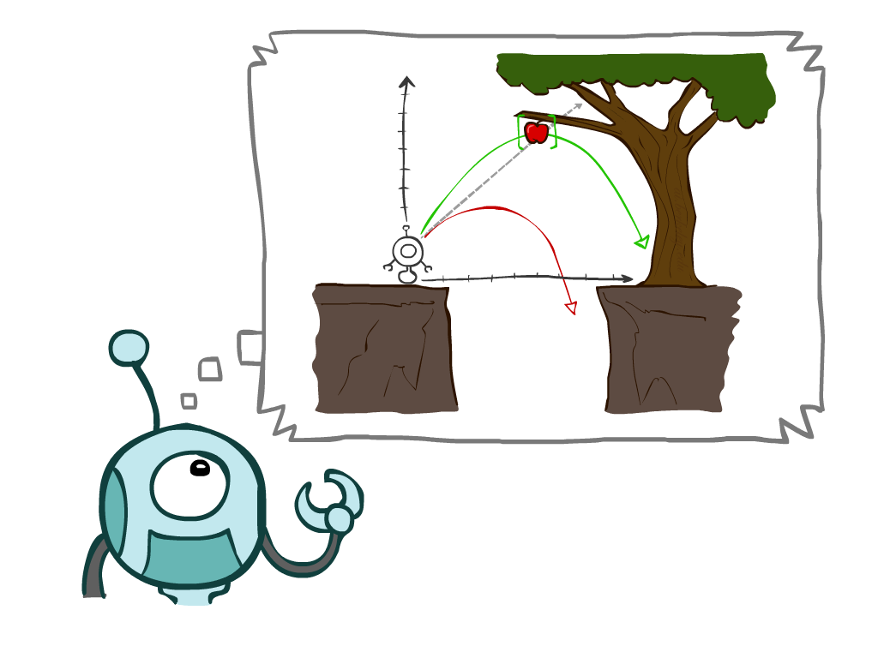
Today
Agents that Plan Ahead
Search Problems
Uninformed Search Methods
Depth-First Search
Breadth-First Search
Uniform-Cost Search
Notes:
General theme in the class:
A goal we have in mind.
A mathematical abstraction to formalize this
Algorithms that operate on these abstractions

Slide 4
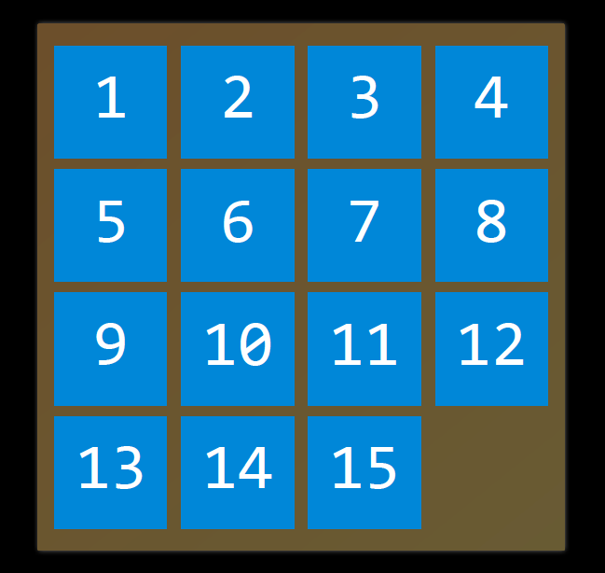
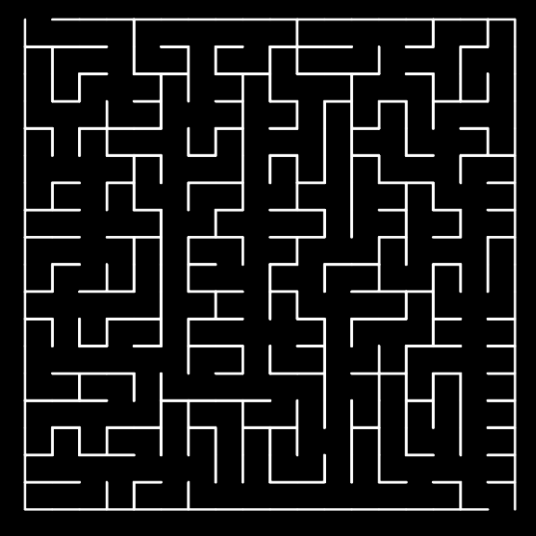
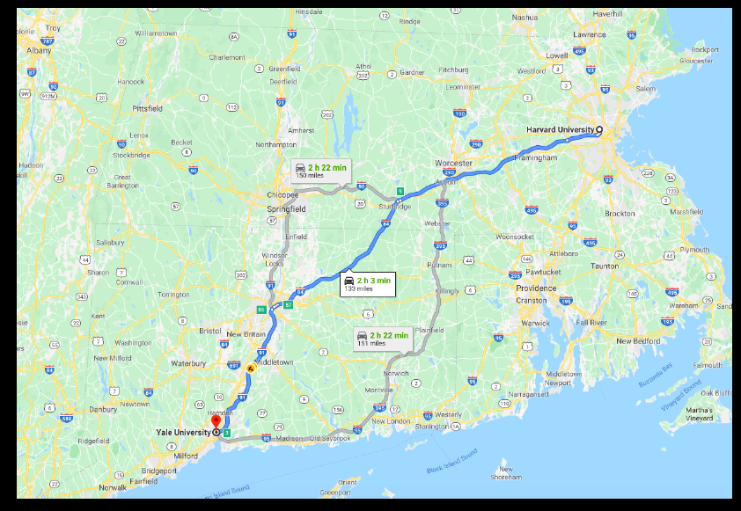
Search
A search algorithm:
takes a problem as input and returns a solution in the form of an action sequence.

Slide 5
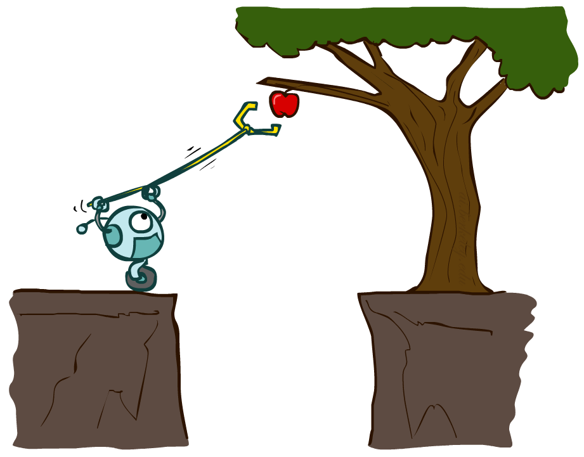
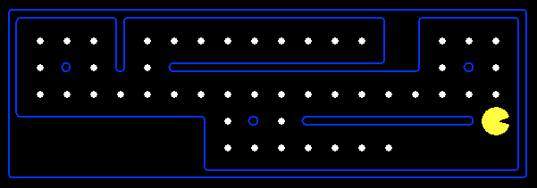
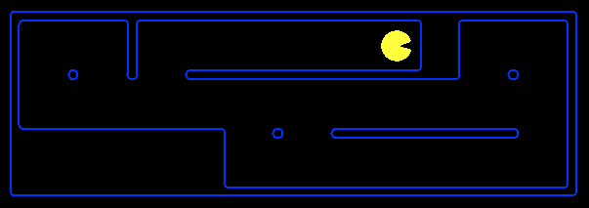
Planning Agents
Planning agents decide based on evaluating future action sequences
Ask “what if”
Decisions based on (hypothesized) consequences of actions
Must have a model of how the world evolves in response to actions
Usually have a definite goal (is this the goal?)
complete planning?
Optimal? : Achieve goal at least cost

Slide 6
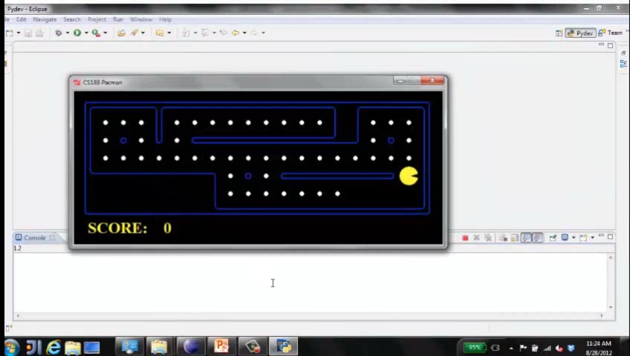
Move to nearest dot and eat it

Slide 7
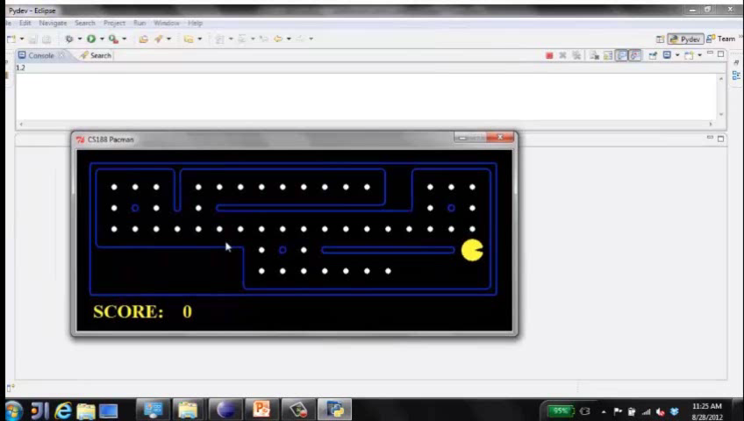
Precompute optimal plan, execute it

Slide 8
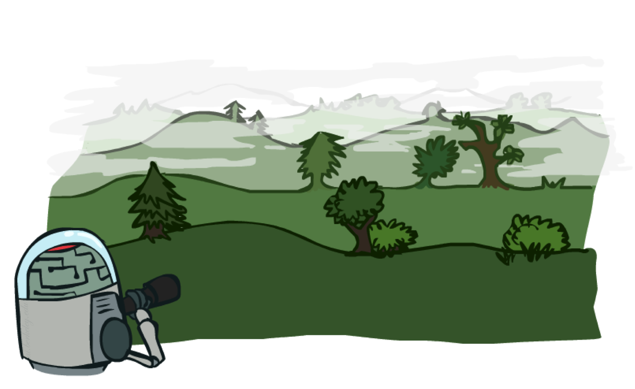
Search Problems

Slide 9
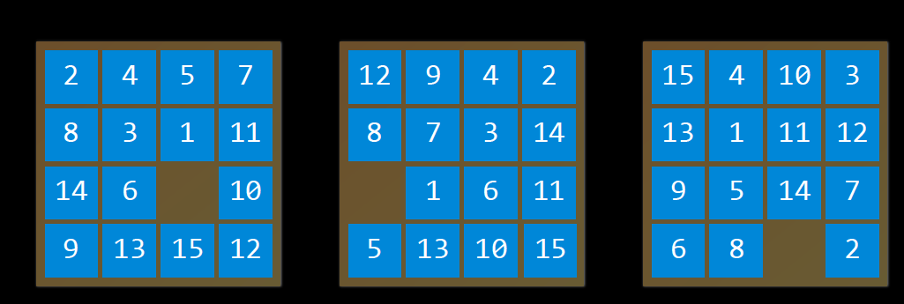
Terms
Agent: entity that perceives its environment and acts upon that environment
State: a configuration of the agent and its environment

Slide 10
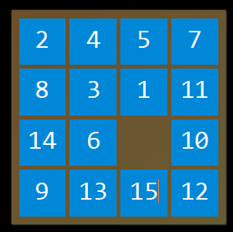
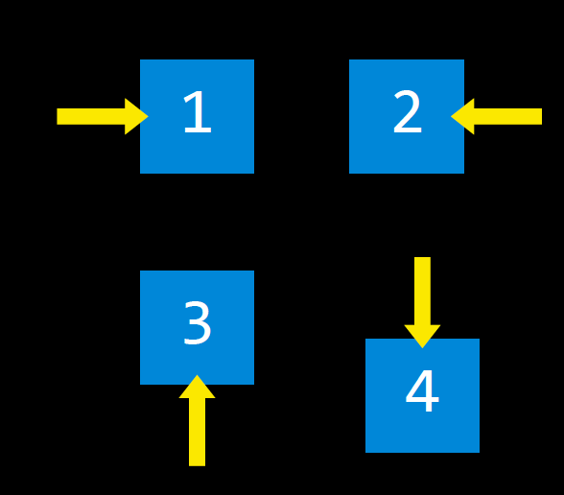
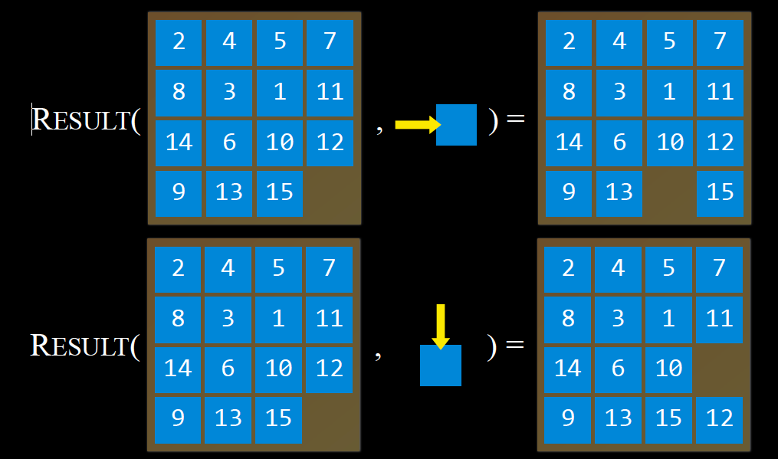
Search Problem has
initial state: the state in which the agent begins
actions choices: that can be made in a state
ACTIONS(s) returns the set of actions that can be executed in state s
transition model: a description of what state results from performing any applicable action in any state
RESULT(s, a) returns the state resulting from performing action a in state s

Slide 11
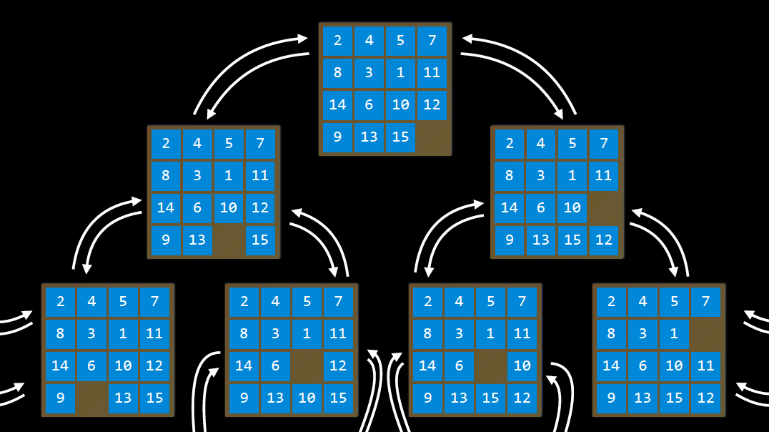
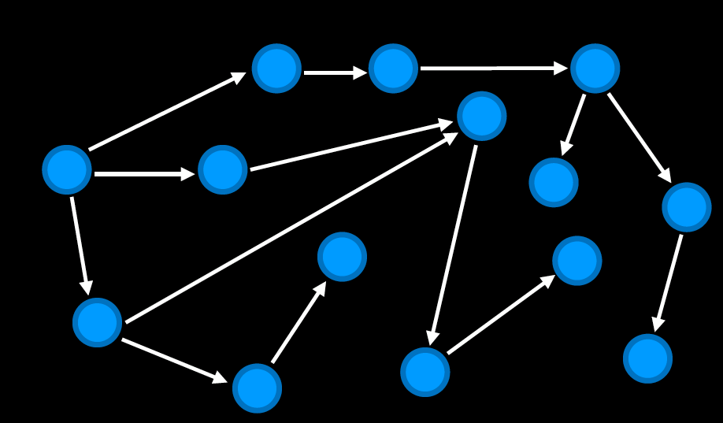
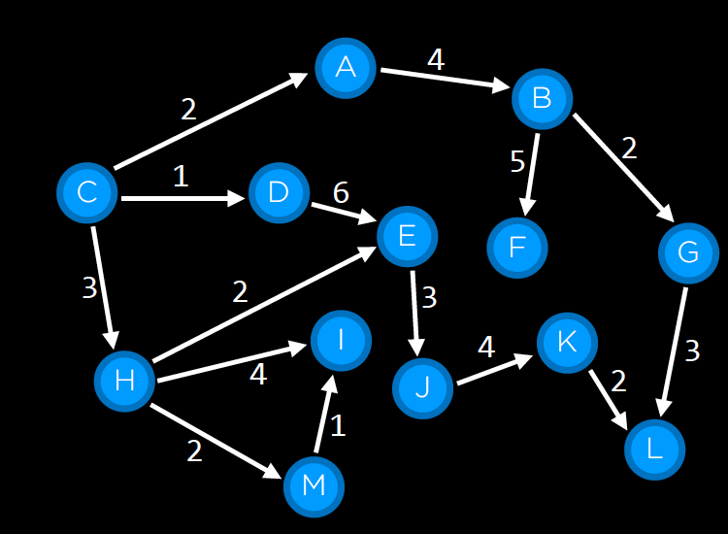
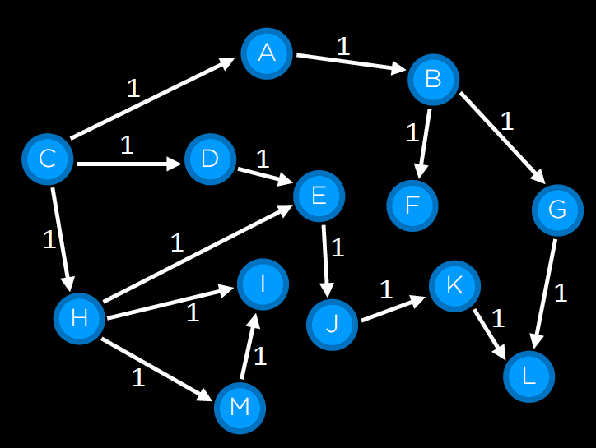
Cont. Search Problem has
state space: the set of all states reachable from the initial state by any sequence of actions
goal test: way to determine whether a given state is a goal state
path cost numerical cost associated with a given path

Slide 12







Search Problems
A search problem consists of:
A state space S
An initial state s₀
Actions A(s) in each state
Transition model Result(s,a)
A goal test G(s)
S has no dots left
Action cost c(s,a,s’)
+1 per step; -10 food; -500 win; +500 die; -200 eat ghost
A solution is an action sequence that reaches a goal state
An optimal solution has least cost among all solutions
N
-9
-9
E
Notes:
Often comes back on exams
Goal test – sometimes more than one state that satisfies having achieved the goal, for example, “eat all the dots”
Abstraction

Slide 13

Search Problems Are Models

Slide 14

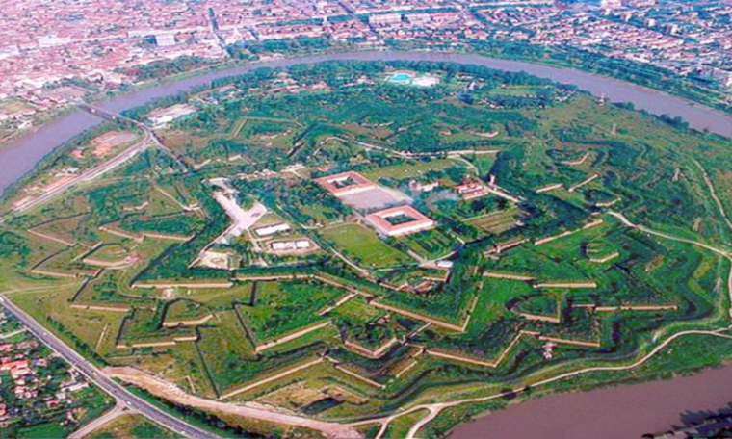
Example: Traveling in Romania
ABSTRACTION : The process of removing detail from a representation

Slide 15
But then…

Slide 16
Example: Traveling in Romania
State space:
Cities
Initial state:
Arad
Actions:
Go to adjacent city
Transition model:
Reach adjacent city
Goal test:
s = Bucharest?
Action cost:
Road distance from s to s’
Solution?

Slide 17
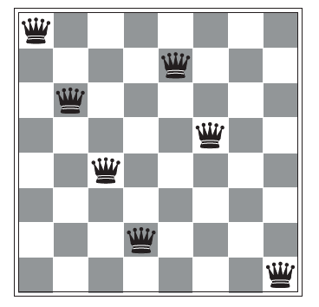
Example: 8-queens problem
State space:
Any arrangement of 0 to 8 queens on the board is a state
Initial state:
No queens on the board
Actions:
Add a queen to any empty square???
Transition model:
Returns the board with a queen added to the specified square
Goal test:
8 queens are on the board, none attacked
Action cost:
xxxxxx
Solution?
Goal: 8 queens on board with no conflicts, i.e., no queen attacking another

Slide 18
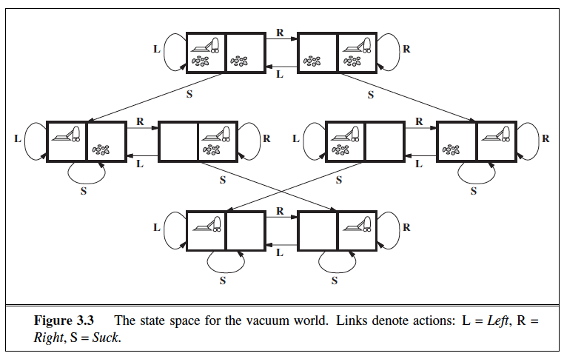
Example: Vacuum Cleaner
State space:
The agent is in one of two locations, each of which might or might not contain dirt.
2 * 2² = 8 possible world states.
Initial state:
Any state
Actions:
Left, Right, Suck
Transition model:
xxxxxx
Goal test:
all squares are cleaned
Action cost:
Each step costs 1, so the path cost is the number of steps in the path.
Solution?

Slide 19
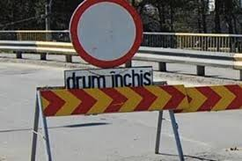
Models are almost always wrong

Slide 20
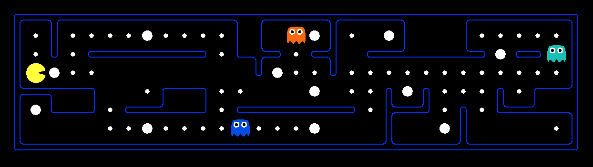
What’s in a State Space?
The world state includes every last detail of the environment
A search state keeps only the details needed for planning (abstraction)
Problem: Pathing
States: (x,y) location
Actions: NSEW
Successor: update location only
Goal test: is (x,y)=END
Problem: Eat-All-Dots
States: {(x,y), dot booleans}
Actions: NSEW
Successor: update location and possibly a dot boolean
Goal test: dots all false
Notes:
Wrong example for “eat-all-dots”: (x, y, dot count). Need bool.
World >= State
Walls? Part of successor.

Slide 21
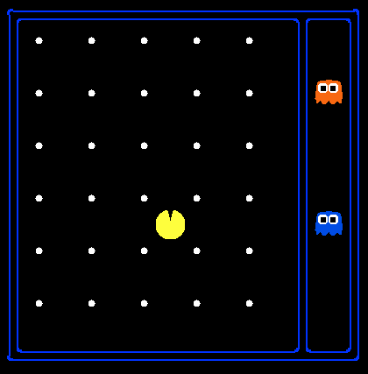
State Space Sizes
World state:
Agent positions: 120
Food count: 30
Ghost positions: 12
Agent facing: NSEW
How many
World states?
120x(2³⁰)x(12²)x4
States for pathing?
120
States for eat-all-dots?
120x(2³⁰)
Notes:
90 * (2^30-1) + 30 * 2^29 = 145 billion
2^29 = 536 870 912

Slide 22
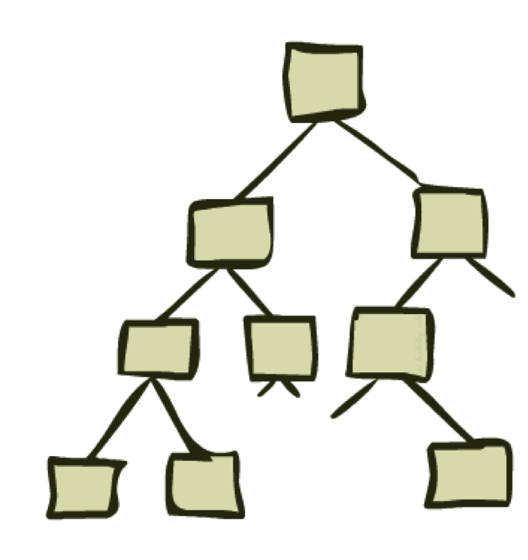
State Space Graphs and Search Trees

Slide 23
How to search
We do this by expanding the current state;
Generating a new set of states…
The essence of search—following up one option now and putting the others aside for later, in case the first choice does not lead to a solution.

Slide 24
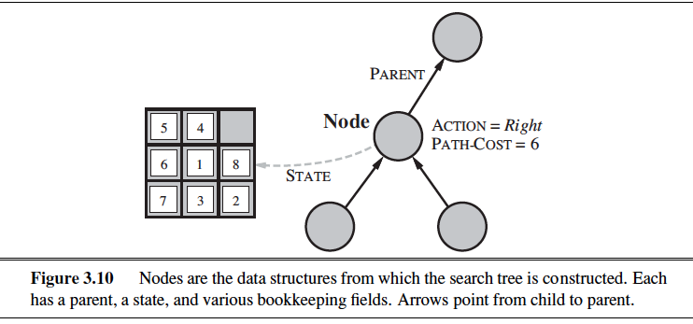
Data Structure
node
a data structure that keeps track of
a state
a parent (node that generated this node)
an action (action applied to parent to get node)
a path cost (from initial state to node)

Slide 25
Approach
• Start with a frontier that contains the initial state.
• Repeat:
• If the frontier is empty, then no solution.
• Remove a node from the frontier.
• If node contains goal state, return the solution.
• Expand node, add resulting nodes to the frontier.

Slide 26
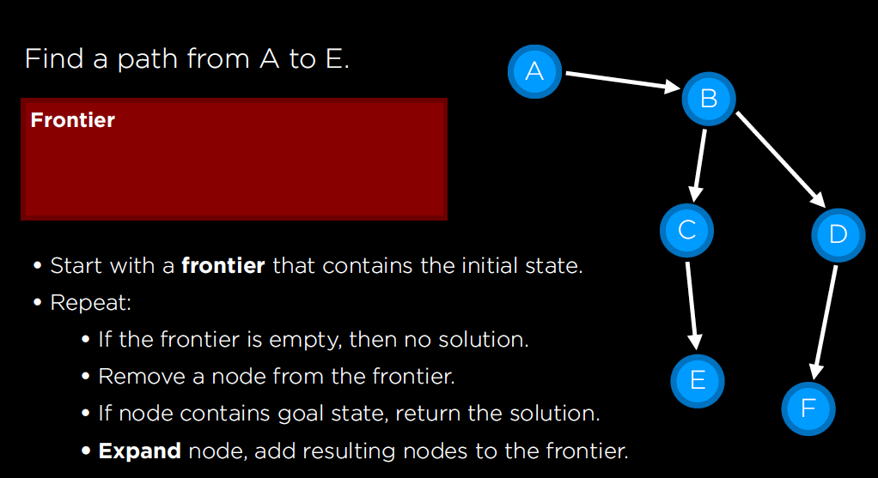

Slide 27
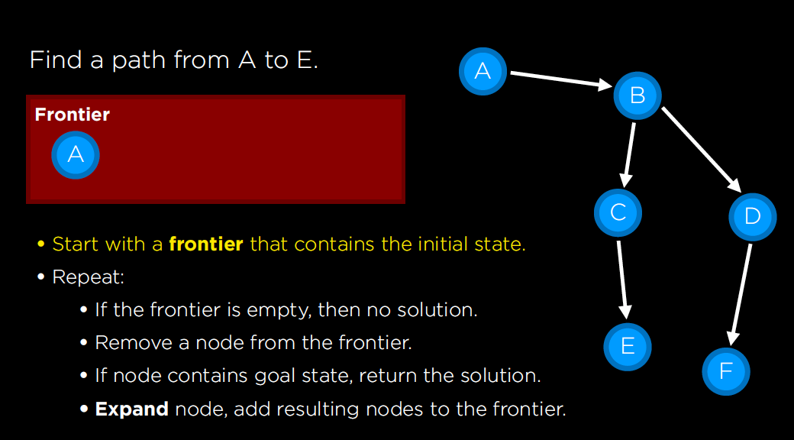

Slide 28
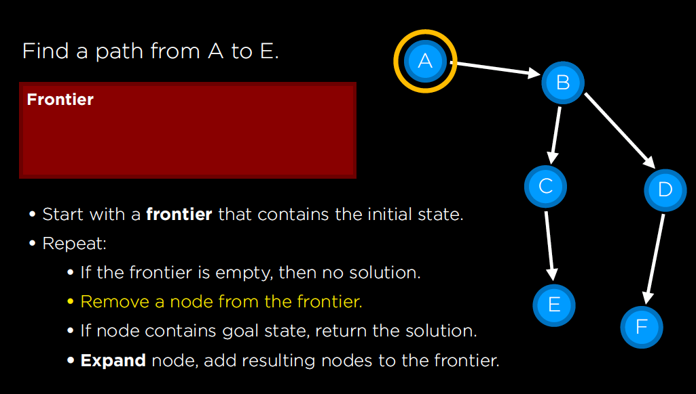

Slide 29
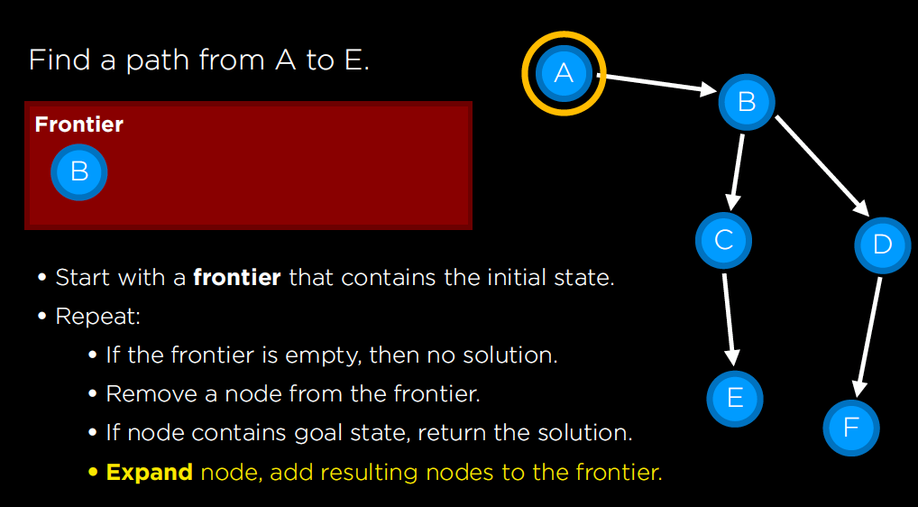

Slide 30
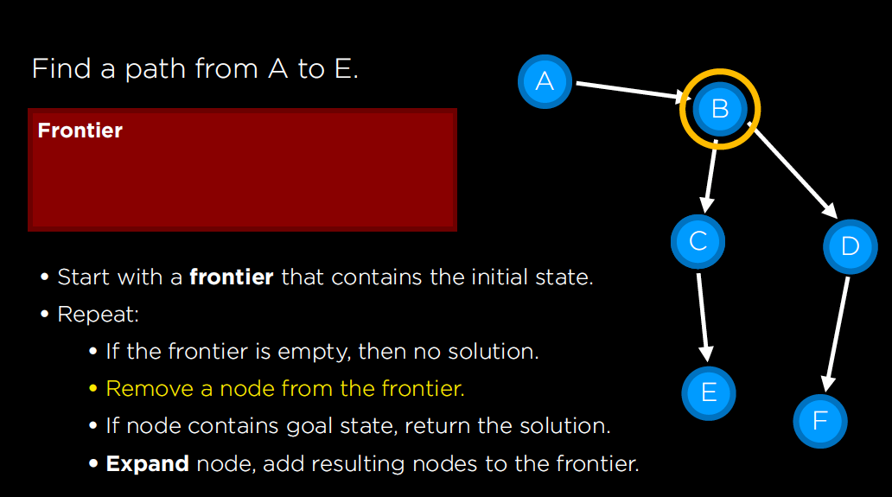

Slide 31
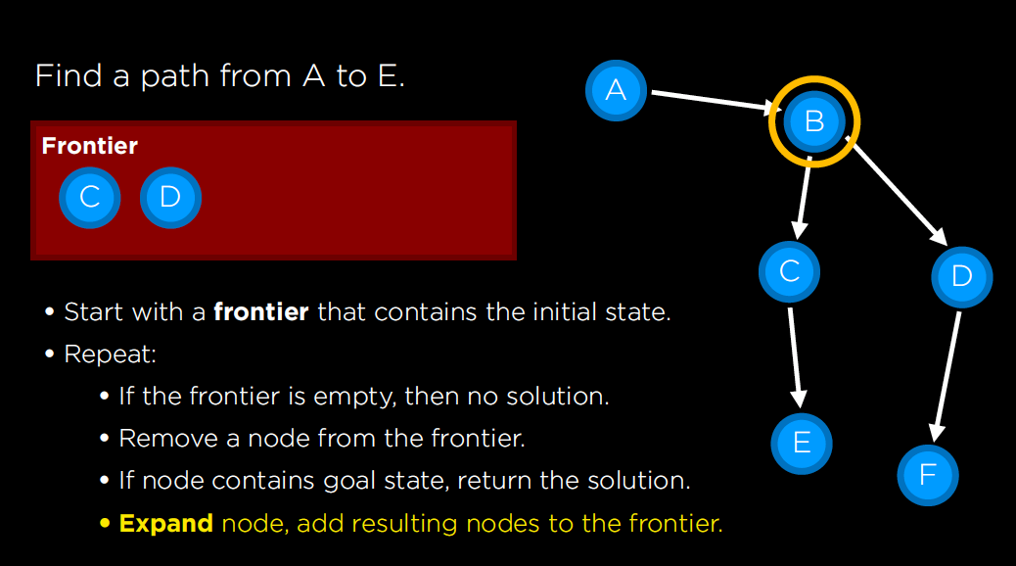

Slide 32
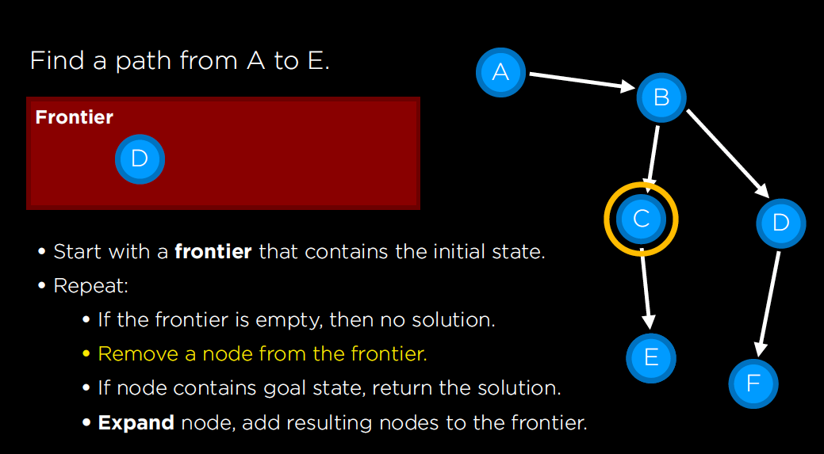

Slide 33
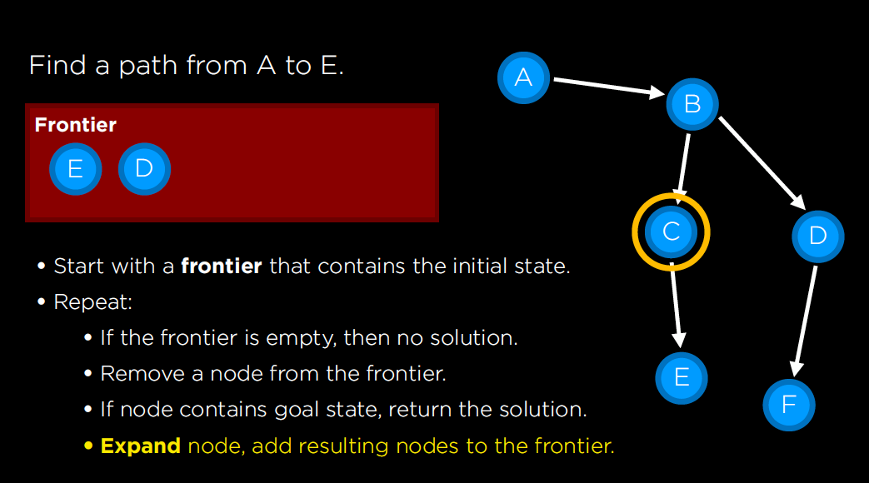

Slide 34
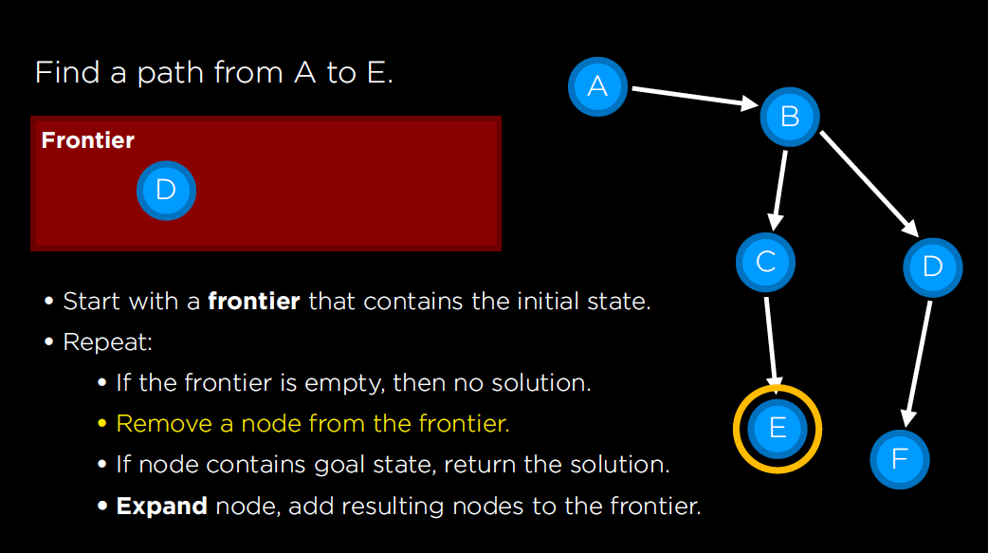

Slide 35
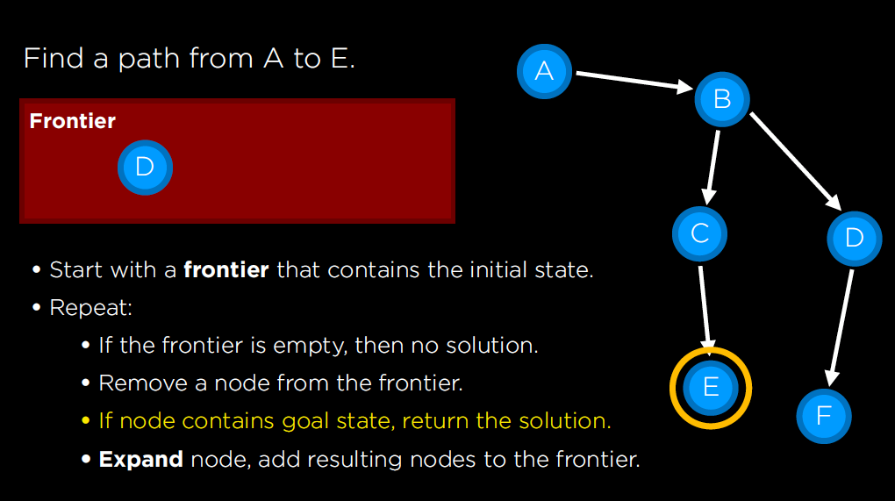

Slide 36
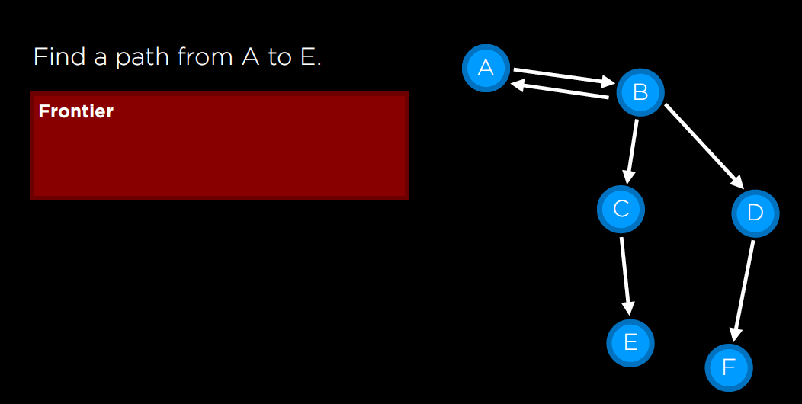
What Could Go Wrong????
As the saying goes, algorithms that forget their history are doomed to repeat it.

Slide 37
State Space Graphs
E
E
E
State space graph: A mathematical representation of a search problem
Nodes are (abstracted) world configurations
Arcs represent transitions (labeled with actions)
The goal test is a set of goal nodes (maybe only one)
In a state space graph, each state occurs only once! No Loops ☺
We can rarely build this full graph in memory (it’s too big), but it’s a useful idea
S
S
N
N
N
E
E
W
S
N
N
N
E
N
S
W
N
E
E
E
E
W
W

Slide 38
State Space Graphs
State space graph: A mathematical representation of a search problem
Nodes are (abstracted) world configurations
Arcs represent successors (action results)
The goal test is a set of goal nodes (maybe only one)
In a state space graph, each state occurs only once!
We can rarely build this full graph in memory (it’s too big), but it’s a useful idea
a
G
b
c
e
d
f
S
h
p
q
r
Tiny state space graph for a tiny search problem

Slide 39
State Space Graphs vs. Search Trees
State Space Graph
Each NODE in in the search tree is an entire PATH in the state space graph.
Search Tree
S
a
G
d
e
p
b
c
q
b
c
e
h
r
d
e
f
a
a
h
r
p
q
f
S
h
We construct the tree on demand – and we construct as little as possible.
p
q
f
q
c
G
p
q
r
q
c
G
a
a

Slide 40

Quiz: State Space Graphs vs. Search Trees
Consider this 4-state graph:
How big is its search tree (from S)?
a
S
G
b

Slide 41
Quiz: State Space Graphs vs. Search Trees
Consider this 4-state graph:
How big is its search tree (from S)?
a
s
a
b
S
G
b
G
a
G
b
a
G
b
G
…
…
Important: Those who don’t know history are doomed to repeat it!

Slide 42
Search Example: Romania

Slide 43
Creating the search tree
frontier

Slide 44
Creating the search tree
expanded
frontier

Slide 45
Creating the search tree
expanded
frontier

Slide 46
General Tree Search
Main variations:
Which leaf node to expand next
Whether to check for repeated states
Data structures for frontier, expanded nodes

Slide 47
Revised Approach
• Start with a frontier that contains the initial state. Queue or Stack?
• Start with an empty explored set.
• Repeat:
• If the frontier is empty, then no solution.
• Remove a node from the frontier.
• If node contains goal state, return the solution.
• Add the node to the explored set.
• Expand node, add resulting nodes to the frontier if they aren't already in the frontier or the explored set.

Slide 48
Measuring problem-solving performance
Before we get into the design of specific search algorithms, we need to consider the criteria that might be used to choose among them. We can evaluate an algorithm’s performance in
four ways:
COMPLETENESS • Is the algorithm guaranteed to find a solution when there is one?
OPTIMALITY • Does the strategy find the optimal solution
TIME COMPLEXITY • How long does it take to find a solution?
SPACE COMPLEXITY • How much memory is needed to perform the search?

Slide 49

uninformed search
Search strategy that uses no problem-specific knowledge

Slide 50
Systematic search
frontier
expanded
reached =
expanded U frontier
unexplored
Frontier separates expanded from unexplored region of state-space graph
Expanding a frontier node:
Moves a node from frontier into expanded
Adds nodes from unexplored into frontier, maintaining property 1

Slide 51
Depth-First Search

Slide 52
Depth-First Search (S→G)
Strategy: expand a deepest node first
Implementation: Frontier is a LIFO stack
a
G
a
c
b
c
b
e
d
e
d
f
f
S
h
h
p
p
r
q
r
q
S
d
e
p
b
c
e
h
r
q
a
a
h
r
p
q
f
p
q
f
q
c
G
q
c
G
a
a

Slide 53
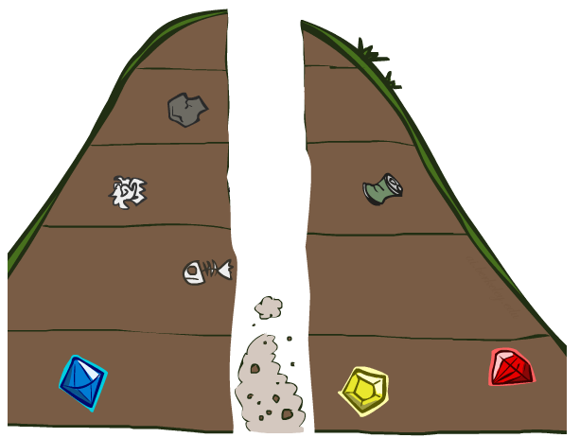
Search Algorithm Properties

Slide 54
Search Algorithm Properties
Complete: Guaranteed to find a solution if one exists?
Optimal: Guaranteed to find the least cost path?
Time complexity?
Space complexity?
Cartoon of search tree:
b is the branching factor
m is the maximum depth
solutions at various depths
Number of nodes in entire tree?
1 + b + b² + …. b^{m} = O(b^{m})
1 node
b
…
b nodes
b² nodes
m tiers
b^{m} nodes

Slide 55
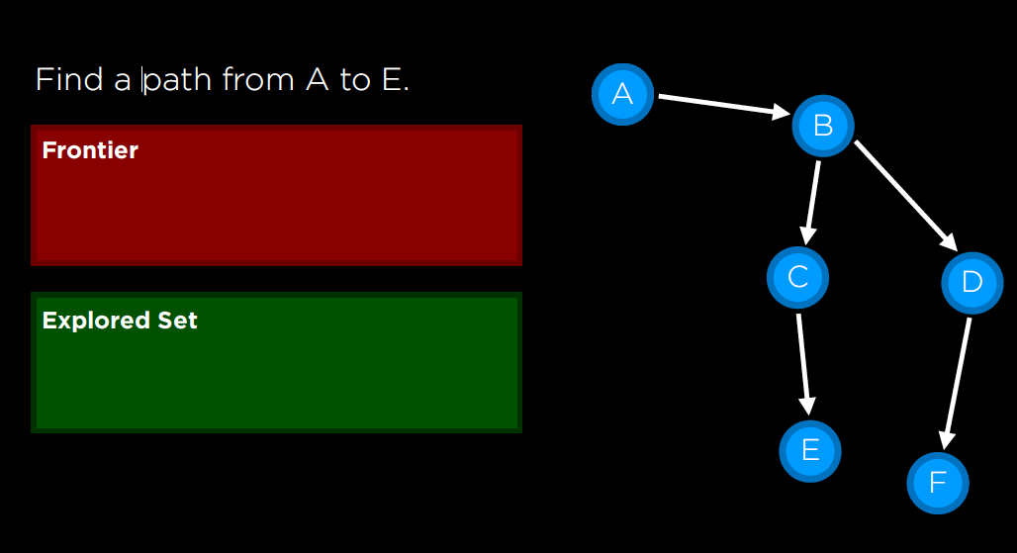
Depth-First Search (DFS) Properties
What nodes does DFS expand?
Some left prefix of the tree down to depth m.
Could process the whole tree!
If m is finite, takes time O(b^{m})
How much space does the frontier take?
Only has siblings on path to root, so O(bm)
Is it complete?
m could be infinite
preventing cycles may help (more later)
Is it optimal?
No, it finds the “leftmost” solution, regardless of depth or cost
1 node
b
…
b nodes
b² nodes
m tiers
b^{m} nodes

Slide 56
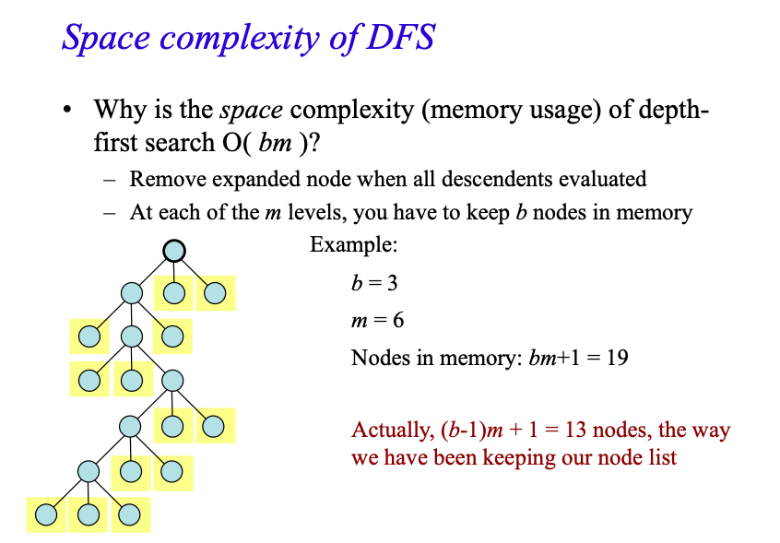

Slide 57
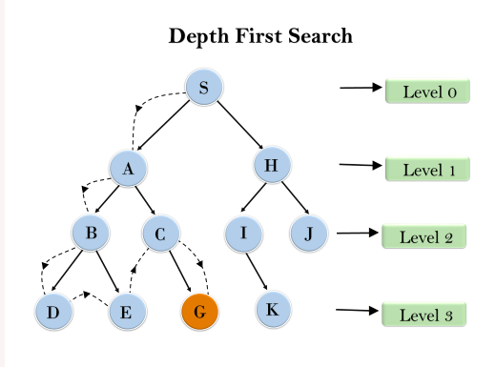
Example

Slide 58
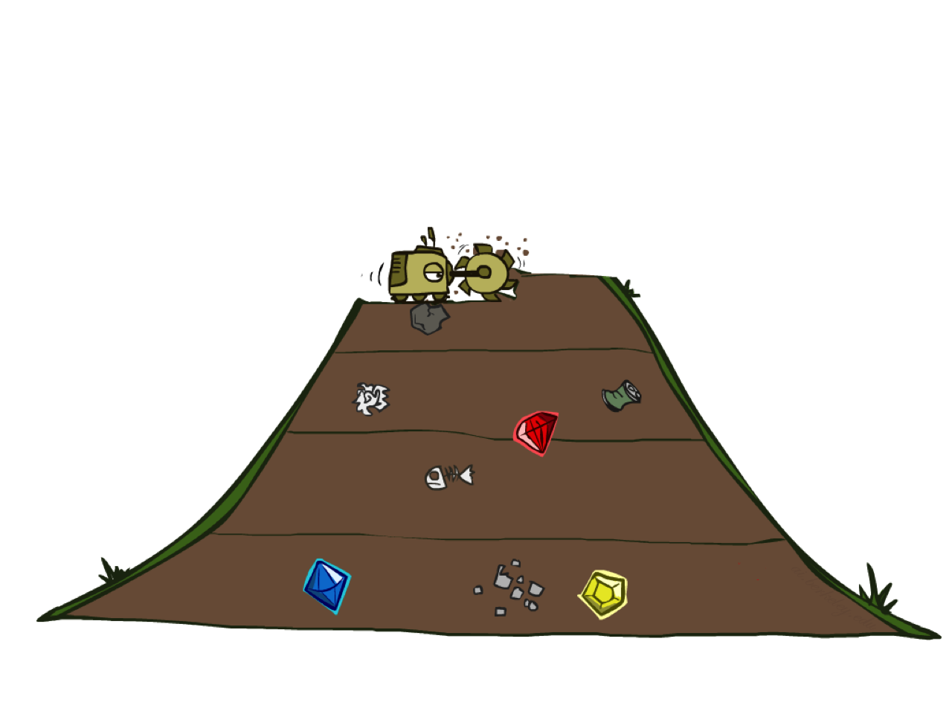
Breadth-First Search

Slide 59
Breadth-First Search
Strategy: expand a shallowest node first
Implementation: Frontier is a FIFO queue
a
G
b
c
d
e
f
S
h
p
q
r
S
d
e
p
Search
Tiers
b
c
e
h
r
q
a
a
h
r
p
q
f
p
q
f
q
c
G
q
c
G
a
a

Slide 60
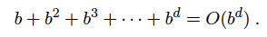
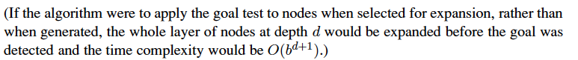
Breadth-First Search (BFS) Properties
What nodes does BFS expand?
Processes all nodes above shallowest solution
Let depth of shallowest solution be s
Search takes time O(b^{s})
How much space does the frontier take?
Has roughly the last tier, so O(b^{s})
Is it complete?
s must be finite if a solution exists, so yes!
Is it optimal?
If costs are equal (e.g., 1)
1 node
b
…
b nodes
s tiers
b² nodes
b^{s} nodes
b^{m} nodes
the total number of nodes generated is

Slide 61
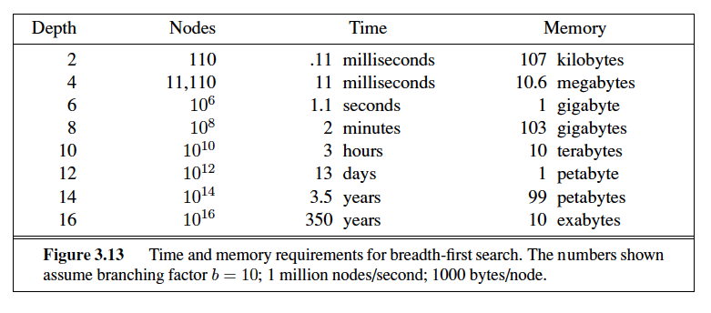
BFS Example
Problem1: the memory requirements are a bigger problem for breadth-first search than is the execution time.
Problem2: time is still a major factor

Slide 63
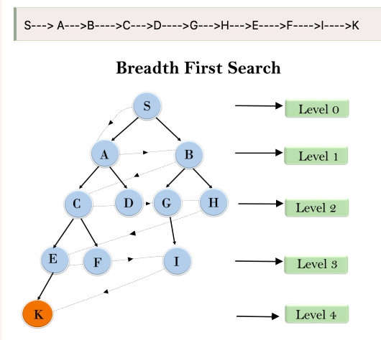

Slide 64
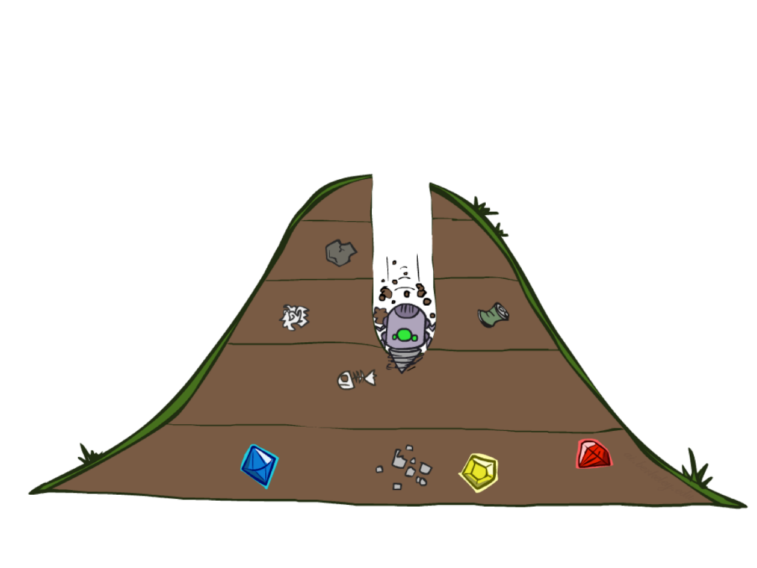
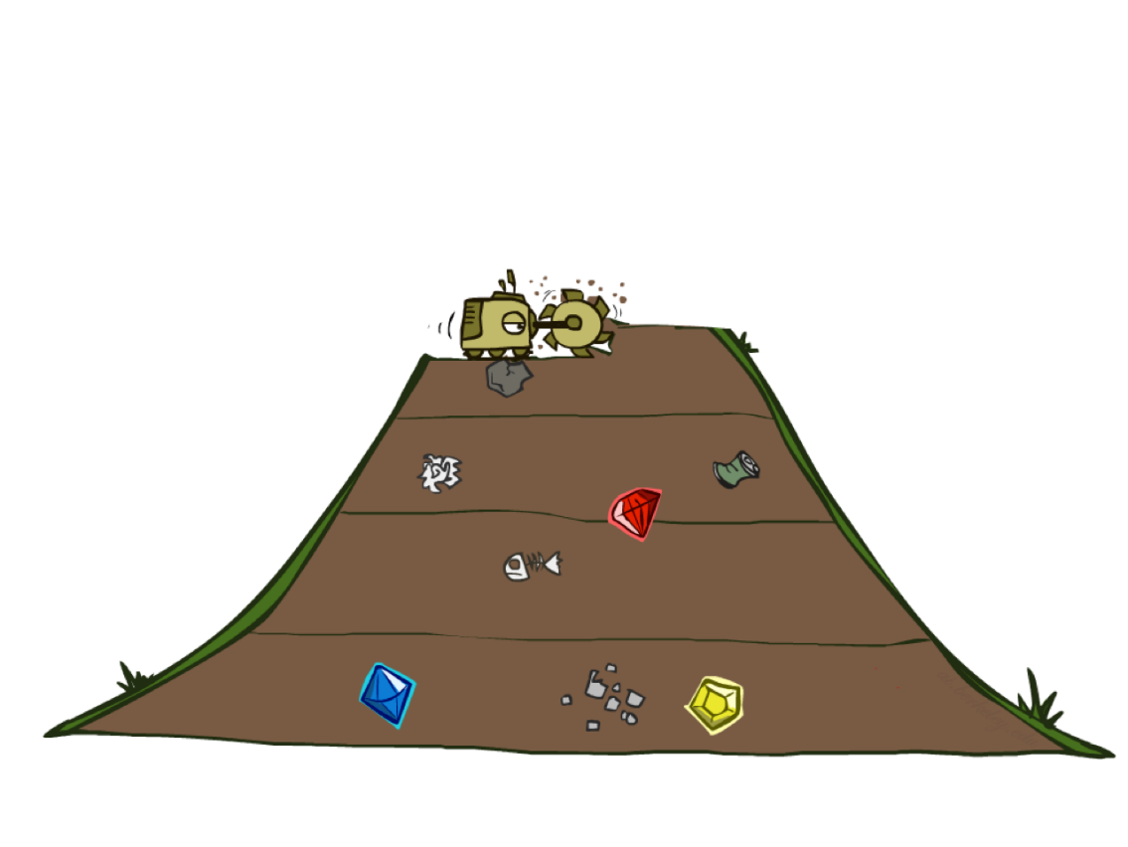
Quiz: DFS vs BFS

Slide 65
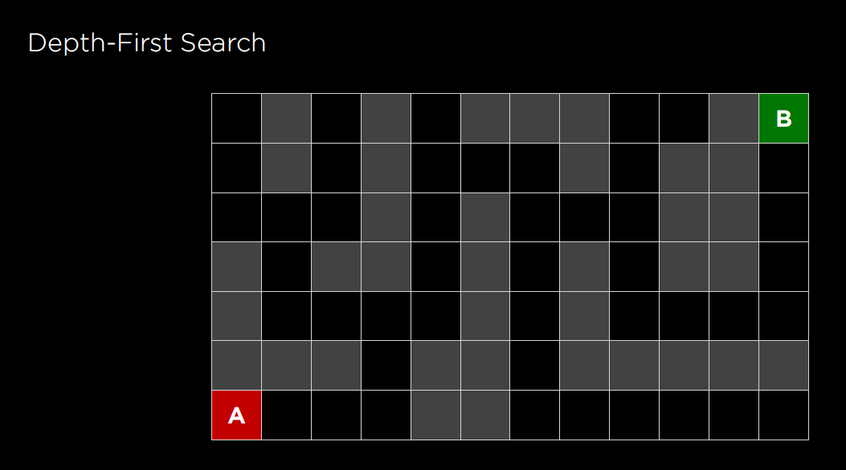

Slide 66
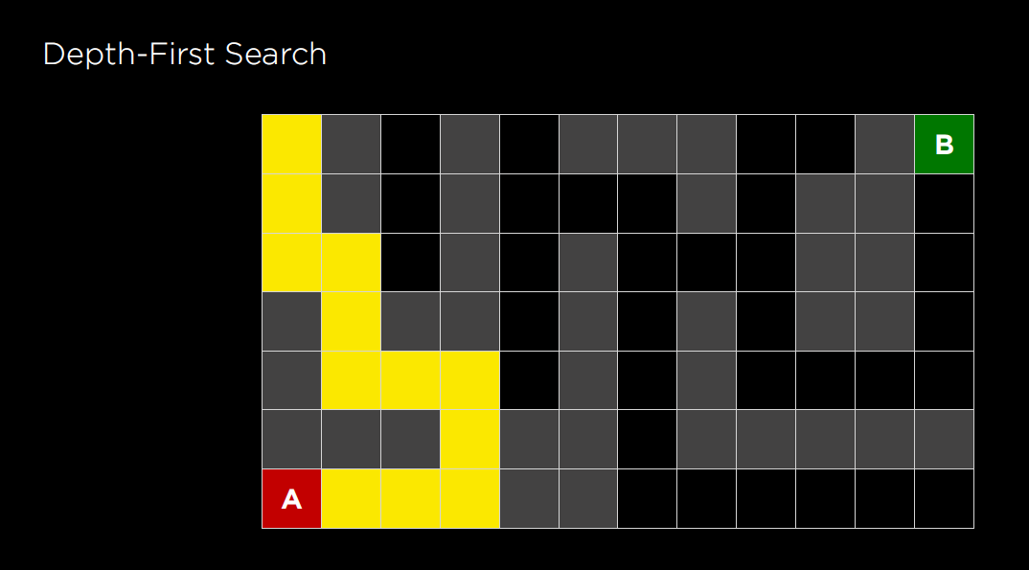

Slide 67


Slide 68


Slide 69


Slide 70


Slide 71


Slide 72


Slide 73


Slide 74


Slide 75


Slide 76


Slide 77


Slide 78


Slide 79


Slide 80
Quiz: DFS vs BFS
When will BFS outperform DFS?
When will DFS outperform BFS?
Notes:
BFS best when there is a shallow solution, s << m
DFS best when solutions all at m, and fairly common at m

Slide 81
Iterative Deepening
Idea: get DFS’s space advantage with BFS’s time / shallow-solution advantages
Run a DFS with depth limit 1. If no solution…
Run a DFS with depth limit 2. If no solution…
Run a DFS with depth limit 3. …..
Isn’t that wastefully redundant?
Generally most work happens in the lowest level searched, so not so bad!
b
…
Notes:
1 + (1+b) + (1+b+b²) + … + (1+b+…+b^{s}) = (s+1) + sb + (s-1)b² + … + b^{s} = O(b^{s})

Slide 82


Slide 83



Slide 84

Uniform Cost Search

Slide 85
Uniform Cost Search
2
G
a
g(n) = cost from root to n
Strategy: expand lowest g(n)
Frontier is a priority queue sorted by g(n)
b
c
1
8
2
2
e
3
d
f
9
8
2
S
h
1
1
p
q
r
15
0
S
d
3
e
9
p
1
b
4
e
5
h
17
r
11
q
16
c
11
Cost contours
a
6
a
h
13
r
7
p
q
f
p
q
f
8
q
c
G
q
c
a
11
G
10
a

Slide 86


Slide 87


S-- > G
→

Slide 88
Uniform Cost Search (UCS) Properties
What nodes does UCS expand?
Processes all nodes with cost less than cheapest solution!
If that solution costs C* and arcs cost at least ε , then the “effective depth” is roughly C*/ε
Takes time O(b^{C*/ε}) (exponential in effective depth)
How much space does the frontier take?
Has roughly the last tier, so O(b^{C*/ε})
Is it complete?
Assuming C* is finite and ε > 0, yes!
Is it optimal?
Yes! (Proof next lecture via A*)
b
g ≤ 1
…
C*/ε “tiers”
g ≤ 2
g ≤ 3

Slide 89
uniform-cost search expands nodes in order of their optimal path cost.
Uniform-cost search does not care about the number of steps a path has, but only about their total cost. Therefore, it will get stuck in an infinite loop if there is a path with an infinite sequence of zero-cost actions

Slide 90


The end of Ch3 sections 1 to 4

Slide 91



Example

Slide 92

DFS ?

Slide 93

IDDFS

